Slide 1

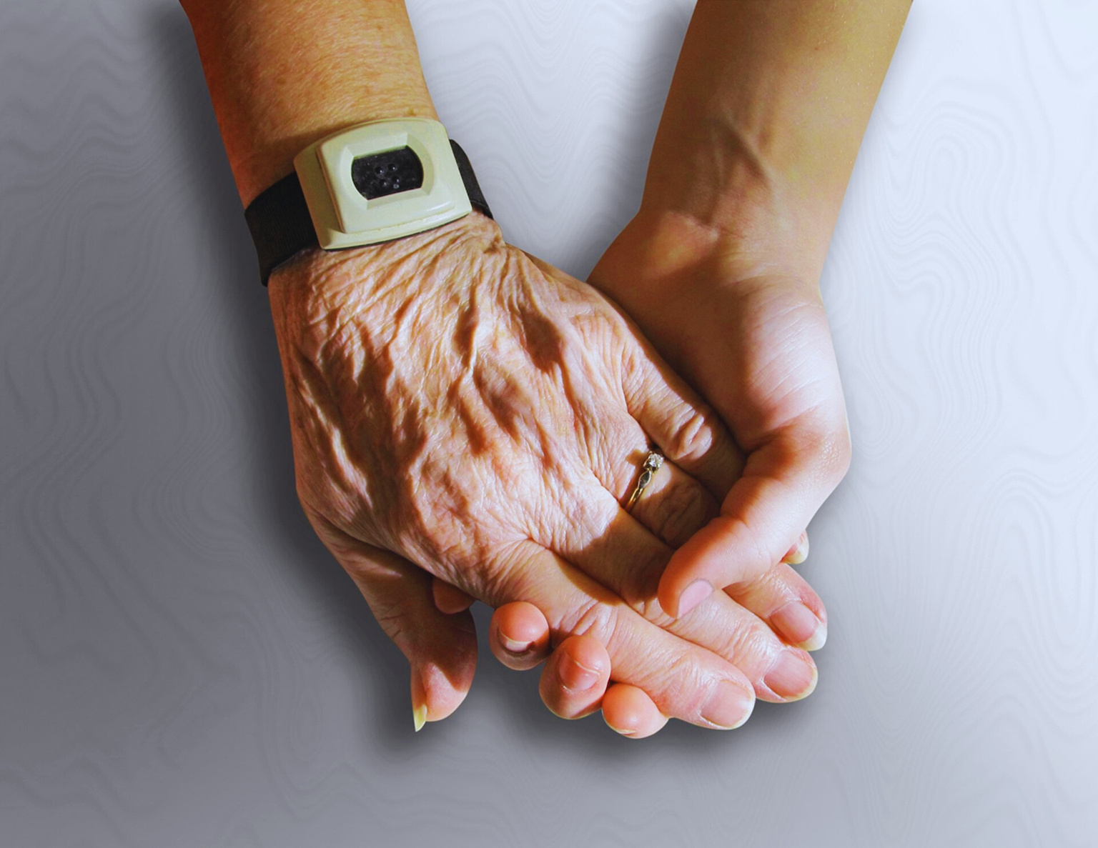

SSN
IFP PROJECT
DIABETES
DETECTION
Through Non Invasive Methods

Slide 2
TEAM MEMBERS:
Abbhinav, First Year, Dept. of Computer Science and Engineering
Karthikeyan, First Year, Dept. of Computer Science and Engineering
S. Oviasree, First Year, Dept. of Computer Science and Engineering
Keerthick V, First Year, Dept. of Information Technology
PROJECT GUIDES:
?Dr. P Mirunalini , Associate Professor, Dept. of Computer Science and Engineering
Dr.D.Thenmozhi, Associate Professor, Dept. of Computer Science and Engineering

Slide 3

OVERVIEW
01
02
03
Problem
Statement
Objective
Existing
System
04
05
06
Proposed System
and Innovation
Modules
Budget Details

Slide 4
BACKGROUND
Diabetes mellitus is a severe disease characterized by high blood glucose levels resulting from dysregulation of the hormone insulin. Diabetes is managed through physical activity and dietary modification and requires careful monitoring of blood glucose concentration.
Blood glucose concentration is typically monitored throughout the day by analyzing a sample of blood drawn from a finger prick using a commercially available glucometer. However, this process is invasive and painful, and leads to a risk of infection. Therefore, there is an urgent need for noninvasive, inexpensive, novel platforms for continuous blood sugar monitoring.

Slide 5


INTRODUCTION
80%
Diabetes is a major public health problem that is approaching epidemic proportions globally.
About 18 million people die every year from cardiovascular disease, for which diabetes and hypertension are major predisposing factors.
20%
Almost 80% of the total adult diabetics are in developing countries.
India leads the global top ten in terms of the highest number of people with diabetes with a current figure of 40.9 million, followed by China with 39.8 million.

Slide 6
PROBLEM STATEMENT
To create a non-invasive model of a diabetes detecting system to monitor the blood glucose levels in an efficient and effective way.
This is done using image processing of the laser incident fingertip image and artificial neural network.
This device can be used for
•For mass screening of diabetic patients.
•For regular monitoring of blood glucose level at home.

Slide 7
OBJECTIVE
Our study aimed to describe a pilot test to test the accuracy of a noninvasive glucose monitoring prototype that uses laser technology based on near-infrared spectroscopy.

Slide 8
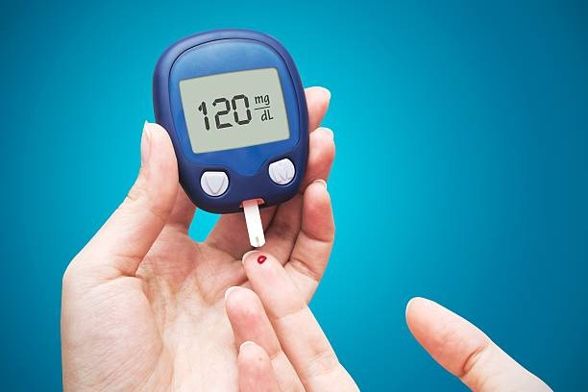
EXISTING SYSTEM
The most common method is using a blood glucose meter, which involves pricking the finger and placing a drop of blood on a test strip.
Continuous glucose monitoring systems are also available, which use a sensor placed under the skin to measure glucose levels throughout the day.
Another method is using urine glucose tests, which detect glucose levels in urine.

Slide 9
DRAWBACKS OF EXISTING SYSTEMS
Invasive and painful
Time consuming
Cross contamination
Expensive
Urine tests are less accurate and not commonly used anymore.

Slide 10
PROPOSED SYSTEM
Our system is based on Raspberry Pi Zero, a portable camera (Raspberry Pi camera), and a visible light laser (675 nm).
The Raspberry Pi camera captures a set of images when a visible light laser passes through skin tissue. The glucose concentration is estimated by an artificial neural network model (ANN) using the absorption and scattering of light in the skin tissue. Blood glucose values obtained by the prototype were compared with commercially available glucometers to estimate accuracy.

Slide 11
LIMITATIONS THAT NEEDS TO BE ADDRESSED
(1) increase the size of the database to improve the robustness
of the artificial neural network model (TO GENERALIZE THE MODEL)
(2) analyze the impact of external factors such as skin color, skin thickness, and ambient temperature in the current prototype
(3) improve the prototype enclosure to make it suitable for easy and efficient capturing of images.

Slide 12
MODULES
Step 1(Image capturing module)
Use a laser source to send light on the index finger, and capture the fingertip by using a raspberry pi camera.
?Step 2 (Feature Extraction Module)
Based on the intensity of the images, histogram is plotted and skin texture is analyzed.
?Step 3 (Prediction Module)
The obtained data values are sent and used as input neurons for Artificial Neural Networks and the glucose level concentration is obtained as the output neuron from the neural network.??

Slide 13
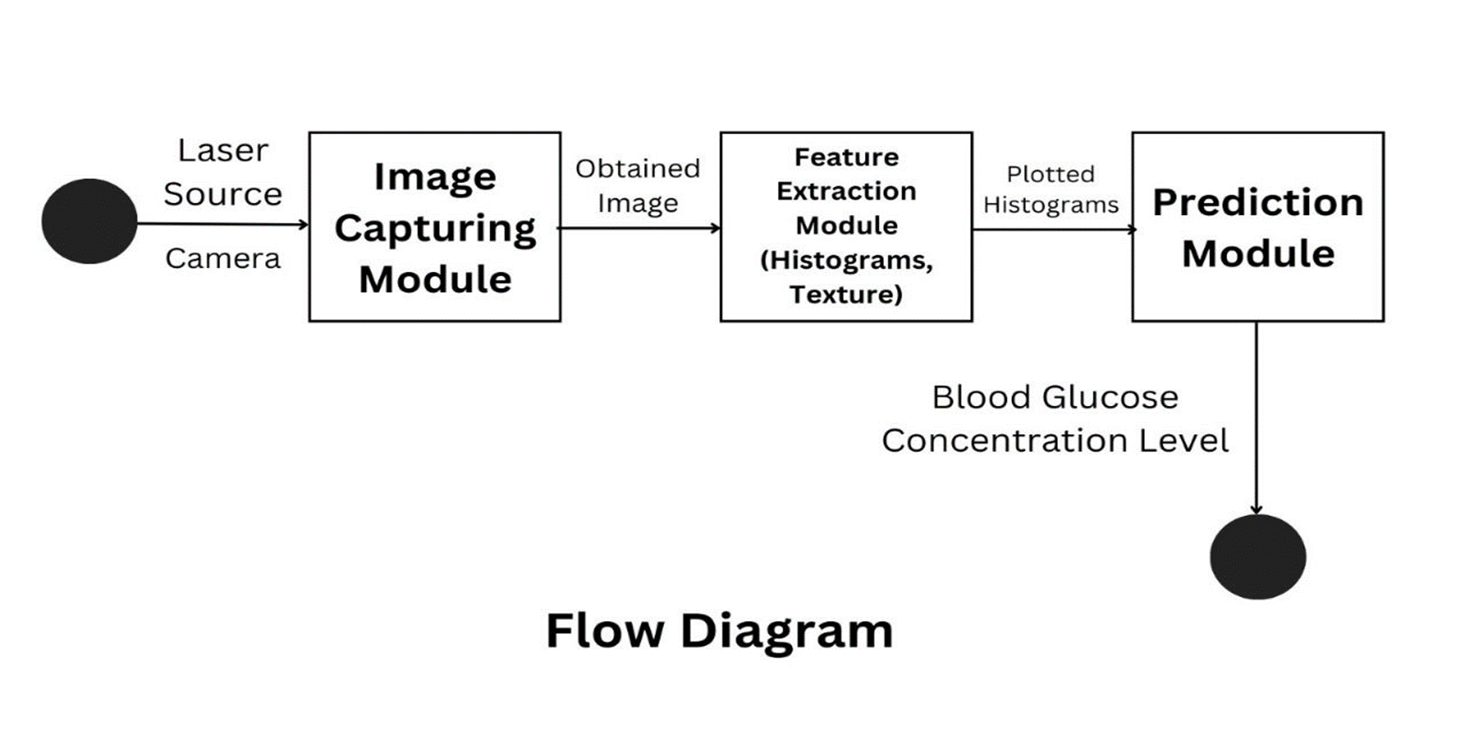
FLOW DIAGRAM

Slide 14
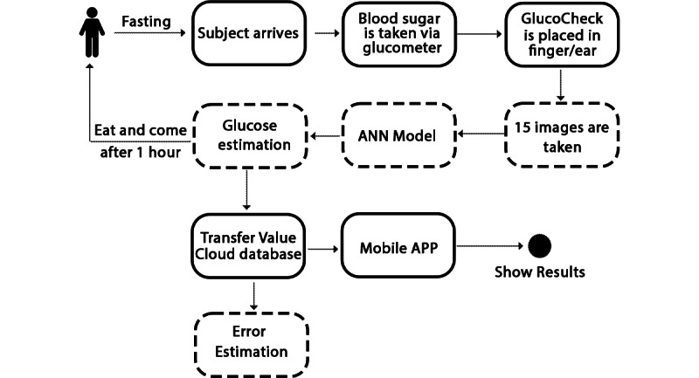
WORKFLOW OF THE PROTOCOL

Slide 15
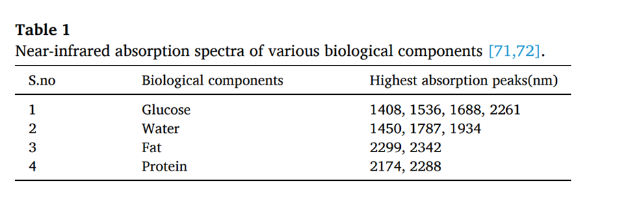
WHY 675 nm LASER?
After analyzing the data in Table 1, it can be concluded that using near-infrared light with a wavelength about 1600 nm has the best effect in monitoring blood glucose concentration
But lasers of wavlength greater than 1400 nm are very dangerous and are largely absorbed by the cornea which may cause blindness or cataracts.

Slide 16

BEER LAMBERT LAW
Our prototype detects blood glucose concentration using noninvasive absorption spectroscopy optical glucose monitoring . It is based on the Beer-Lambert law of absorption that is shown in equation 1.
where I0 is the initial light intensity (W/cm2), I is the intensity of the ith at any depth within the absorption medium in W/cm2, l is the absorption depth within the medium in centimeters, e is the molar extinction coefficient in L/(mmol cm), and c is the concentration of absorbing molecules in mmol/L

Slide 17
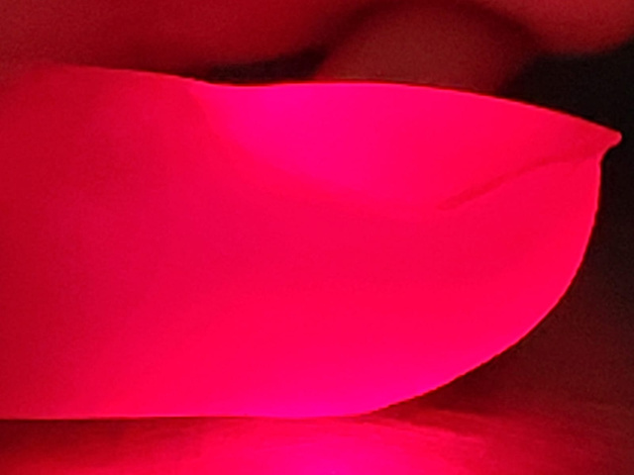
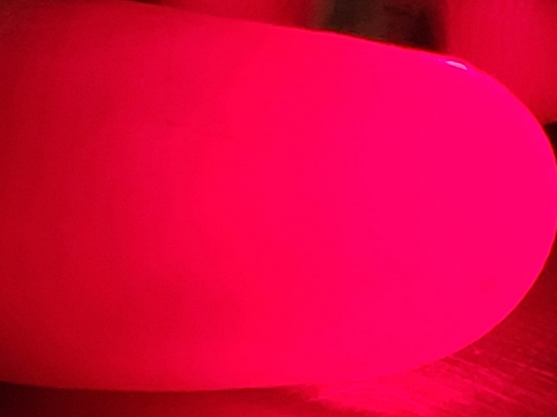
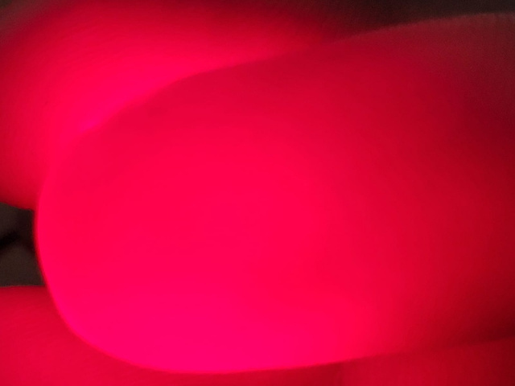
EXPERIMENTAL DATA
All the images were then appended to a single data array with a corresponding label array. Then, we performed data augmentation (cropping, zooming, height and width shift, horizontal flipping), which allowed us to expand the variety of data available for training the model as we had a minimal amount of data. The data were then passed to our model for glucose estimation.
Fingertip images collected from volunteers.

Slide 18
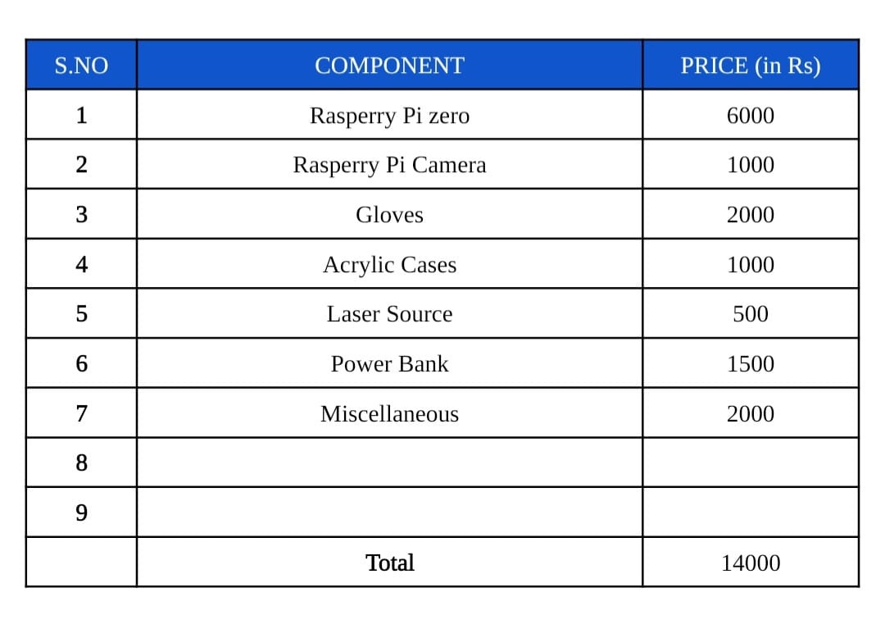
BUDGET DETAILS

